Slide 1
Upstream Matters: What’s Really Affecting Our Health?
June 7, 2016
#nvhfsummit16

Slide 2
Intentionally Designing Health and Well-Being in Northern Virginia
Marissa J. Levine, MD, MPH, FAAFP
Virginia State Health Commissioner
The Virginia Department of Health

Slide 3
Outline
Discuss factors that affect health
Review Virginia and this region’s health status
Describe a Population Health Improvement Approach
Introduce the Virginia State Health Improvement Plan

Slide 4
County Health Rankings

Slide 5
Health Factor Rankings for Virginia Counties (2016)
Notes:
Health factors are the four big categories:
Social and economic factors
Health Behaviors
Clinical factors
Physical environment

Slide 6
Health Outcome Rankings for Virginia Counties (2016)
Notes:
Outcomes are quality and length of life (morbidity and mortality)

Slide 7
Data Source: Virginia Department of Health presentation to Joint Commission on Health Care, September 6, 2014
7

Slide 8
Notes:
Think alignment

Slide 9
AMONG ALL STATES, Virginia RaNKS 21ST IN HEALTH STATUS
Data Source: America’s Health Rankings, United Health Foundation Scorecard-2015
9

Slide 10
Infant Mortality
Source: VDH Division of Health Statistics, compiled by the Division of Policy & Evaluation, Office of Family Health Services

Slide 11
Health Opportunity Index
Educational Attainment
Population Density
Spatial Segregation
Population Churning
Job Participation
Income Diversity
Affordability of Housing and Transportation
EPA Environmental Hazards
Food Access
Material Deprivation
Walkability
Access to Care
Employment Access
HOI
Notes:
What is the HOI?.....is a tool for identifying some key SDOH - socioeconomic, demographic, and environmental processes that explain how race, class, and geography influence health outcomes.
In effect the HOI helps answer important questions. For instance it answers the question “how do race and poverty act to influence life expectancy and which policies are needed?”
And as a result, identifies key policy areas for health equity promoting policy intervention.
Life expectancy, Disability adjusted Life Expectancy, and Infant Mortality were chosen as the health outcome of interest to evaluate the HOI for several reasons:
It provides a generally accepted global indication of health across a population and across the life span.
It summarizes the overall health of a population in an easily understood manner. It answers the question, “How long a life can I expect to live if I am typical member of my local community?”
It provides a general measure of health without reference to the specific cause of a condition such as stroke or health disease. Therefore inaccuracies in determining causes of death are controlled for.
It is consistent with research suggesting that SES and other SDOH are fundamental causes of disease, such that low income, limited social support, etc. are associated with multiple causes of death regardless of their associated risk factors.

Slide 12
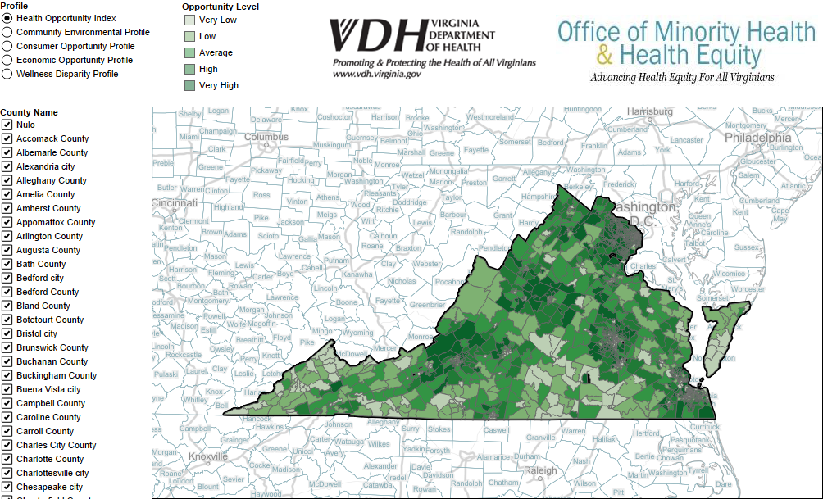
https://www.vdh.virginia.gov/omhhe/hoi/

Slide 13
Moderate HOI Areas
* Per 100,000 Population ages 18 years and older
Notes:
The Prevention Quality Indicators (PQIs) are a set of measures that can be used with hospital inpatient discharge data to identify quality of care for "ambulatory care sensitive conditions." These are conditions for which good outpatient care can potentially prevent the need for hospitalization or for which early intervention can prevent complications or more severe disease.
http://www.qualityindicators.ahrq.gov/Default.aspx

Slide 14
The Geography of Inequality
Avoidable Hospitalization Rate (Diabetes & COPD)
Moderate HOI Areas

Slide 15
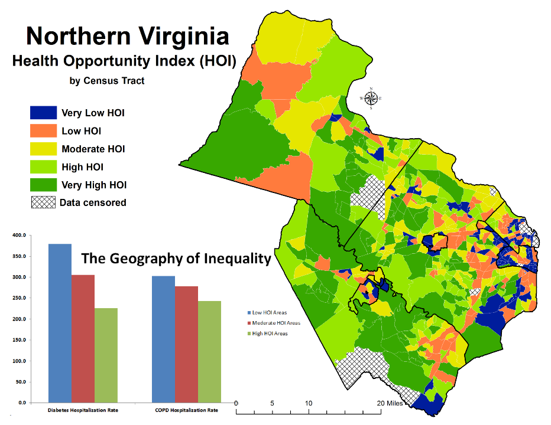
Notes:
The index uses many social, economic, educational, demographic and environmental variables that have been shown (evidence –based) to be related to the wellbeing of a community, and related directly or indirectly to the health status of a population. The goal is to develop an approach which provides communities with more than a “score” or a ranking. The Index is first of all very “local” (census tract) ~it is computed for essentially neighborhoods. Counties/cities do not display sufficient detail to suggest how best to target local concerns.

Slide 16
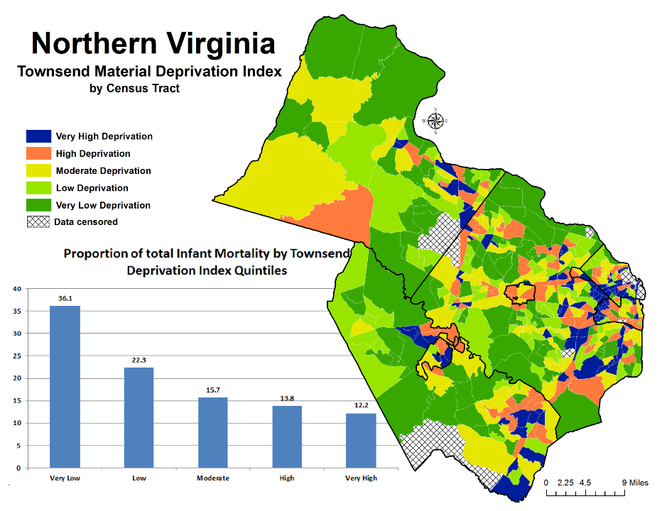
Notes:
Townsend deprivation index is a measure of material deprivation. According to Townsend, “Material deprivation entails the lack of goods, services, resources, amenities and physical environment which are customary, or at least widely approved in the society under consideration
4 indicators make up Towsend Material Deprivation Index:
overcrowding (>2 persons per room),
unemployment,
% of persons no vehicle or car,
% of person who rent

Slide 17
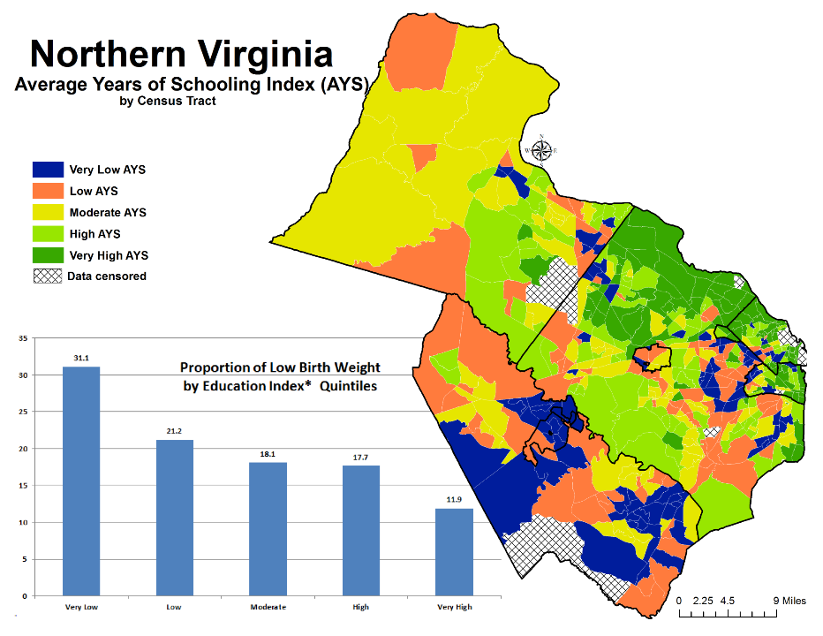
*Average Years of Schooling

Slide 18
Intentional Design: A Population Health Approach
18

Slide 19
Create a System of Healthcare
Build Prevention Everywhere
Health Status Assessment
Data-driven decision making and feedback
Redefine Health
Strong Start for All Children
HEALTHY CONNECTED COMMUNITY
Notes:
“All Hands on Deck”
Listen to the People
Start anywhere but start!
Align, focus and be intentional
Health status assessment (local, regional, statewide)
Promote data-driven decision making and feedback directed toward outcomes that matter to the people of Virginia
Assure primary care and care coordination for all Virginians
RWJF
Good health flourishes across geographic, demographic and social sectors.
Attaining the best health possible is valued by our entire society.
Individuals and families have the means and the opportunity to make choices that lead to the healthiest lives possible.
Business, government, individuals, and organizations work together to build healthy communities and lifestyles.
Everyone has access to affordable, quality health care because it is essential to maintain, or reclaim, health.
No one is excluded.
Health care is efficient and equitable.
The economy is less burdened by excessive and unwarranted health care spending.
Keeping everyone as healthy as possible guides public and private decision-making.
Americans understand that we are all in this together.

Slide 20
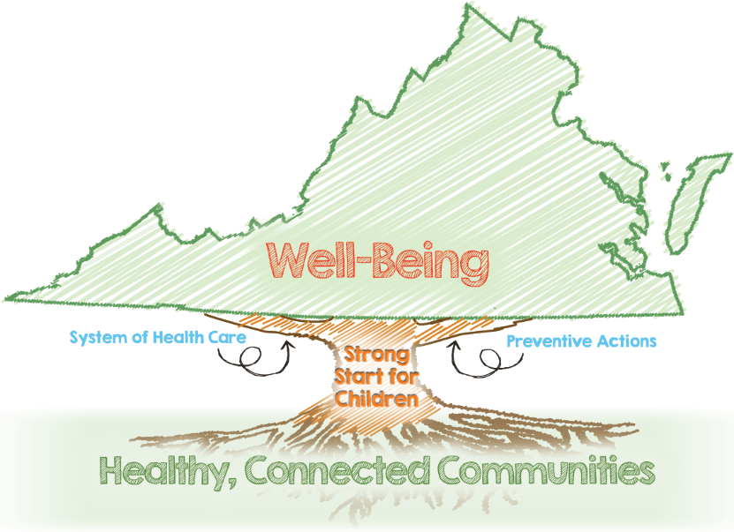
http://www.vdh.virginia.gov/Administration/VPfWB/
Notes:
HEALTHY, CONNECTED COMMUNITIES
H.S. Grads Enrolled in Higher Ed
Cost-Burdened Households
Consumer Opportunity Index
Economic Opportunity Index
Districts with Collaborative Improvement Processes
PREVENTIVE ACTIONS
Adults Not Participating In Physical Activity
Adults Who Are Overweight or Obese
Households That Are Food Insecure
Adults Using Tobacco
Adults Vaccinated Against Influenza
Adolescents Vaccinated Against HPV
Adults Screened for Colorectal Cancer
Percent of Adults With Adverse Childhood Experiences
Disability-free Life Expectancy
STRONG START FOR CHILDREN
Teen Pregnancy Rate
Kindergarteners Not Meeting PALS-K Benchmark
Third Graders Passing Reading SOL
Infant Mortality Rate by Race
SYSTEMS OF HEALTH CARE
Adults With A Regular Health-care Provider
Avoidable Cardiovascular Disease Deaths
Mental Health and Substance Abuse Hospitalizations
Avoidable Hospital Stays
Adults Whose Poor Health Kept Them from Usual Activities
Providers With Electronic Health Records
Health Districts With EHRs
Entities Connected to the Health Information Exchange
Hospitals Meeting State Goal for Prevention of C. difficile Infections

Slide 21
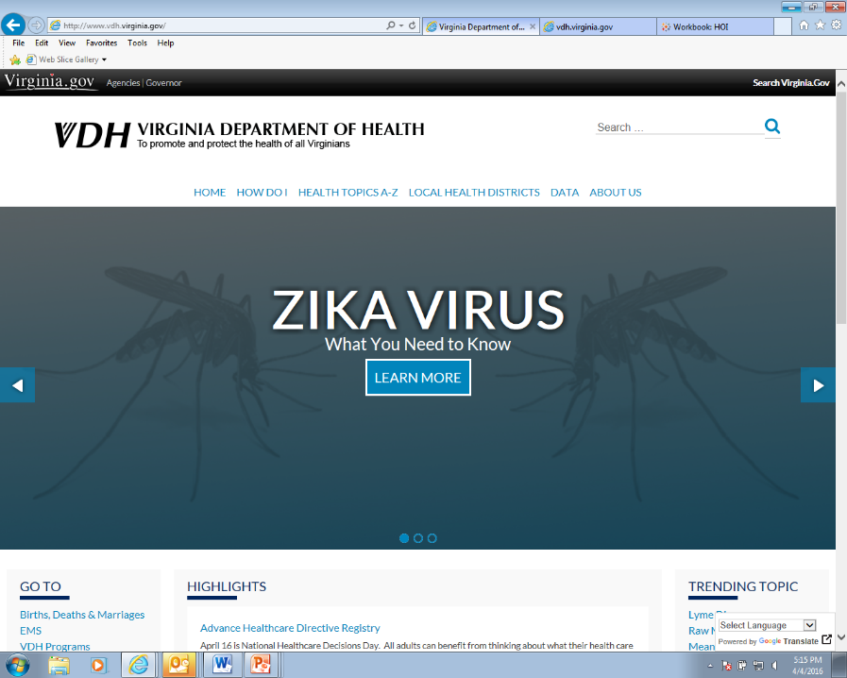

Slide 22
Thank You! Together, we will make Virginia the healthiest state in the nation

Slide 23
A Study in Contrasts: Why Life Expectancy Varies In Northern Virginia
Northern Virginia Health Summit
June 7, 2016
Springfield, Virginia
Steven H. Woolf, MD, MPH
Center on Society and Health
Virginia Commonwealth University

Slide 24
Acknowledgments
Northern Virginia Health Foundation
Burness Communications
Coauthors:
Derek A. Chapman, PhD
Jong Hyung Lee, MS
Lauren Kelley, MPH
Steven A. Cohen, DrPH, MPH
Production: Sarah Simon

Slide 25
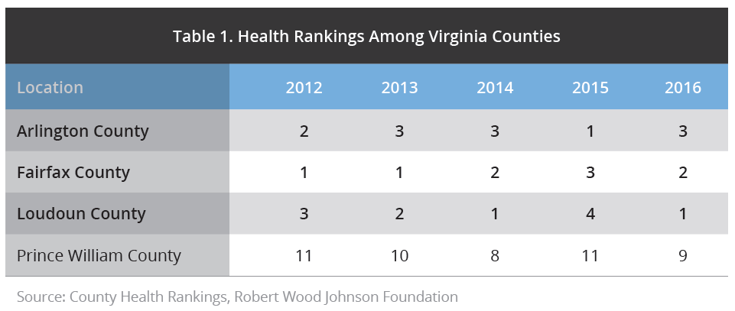
The good health of Northern Virginia

Slide 27
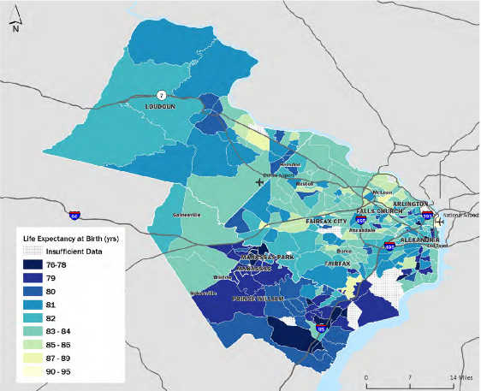
Life expectancy in Northern Virginia, by census tract

Slide 28
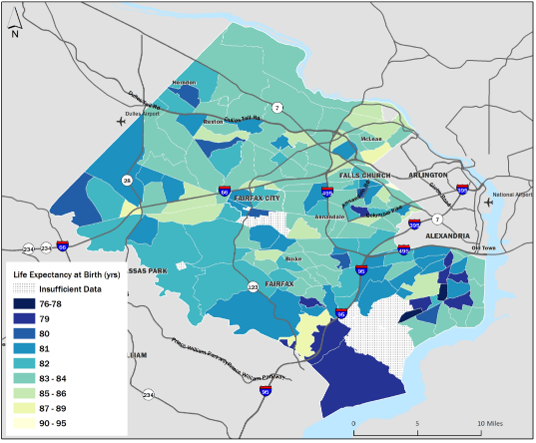
Life expectancy, Fairfax County, by census tract

Slide 29
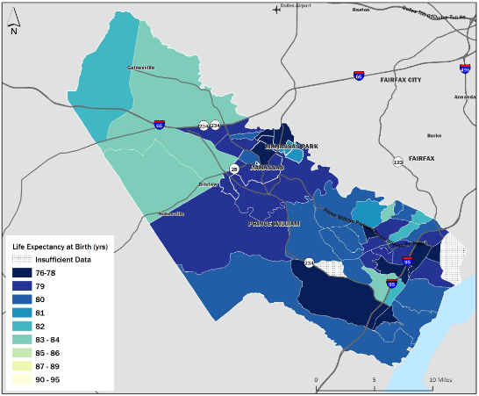
Life expectancy, Prince William County, by census tract

Slide 30
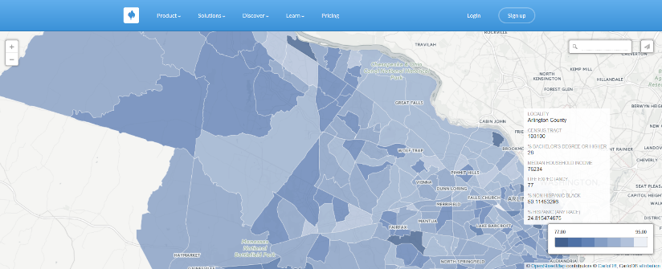
Online interactive tool
http://novahealthfdn.org/life-expectancy-nova/

Slide 31
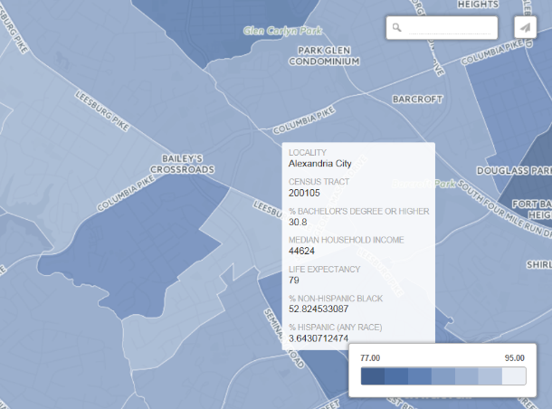
Online interactive tool (continued)

Slide 32
Methods
Analysis conducted by Center on Society and Health, Virginia Commonwealth University
Life expectancy examined at census tract level for four counties (Arlington, Fairfax, Loudoun, and Prince William) and for five cities (Alexandria, Falls Church, Fairfax, Manassas, and Manassas Park)
Mortality data pooled over 14 years (2000-2013), obtained from Virginia Department of Health
Population estimates from 2004- 2009, obtained from U.S. Census Bureau’s American Community Survey
Year 2000 census tract boundaries applied for consistency

Slide 33
Social and Economic Factors
Health Systems
Medical Care
Public Health
Health Outcomes
Mortality
and
Morbidity
Physical and Social Environment
Individual Behaviors
Public Policies and Spending
Source: Adapted from Woolf SH, Aron L, eds. U.S. Health in International Perspective: Shorter Lives, Poorer Health. Panel on Understanding Cross-National Health Differences Among High-Income Countries. National Research Council, Committee on Population, Division of Behavioral and Social Sciences and Education, and Board on Population Health and Public Health Practice, Institute of Medicine. Washington, DC: The National Academies Press, 2013.

Slide 34
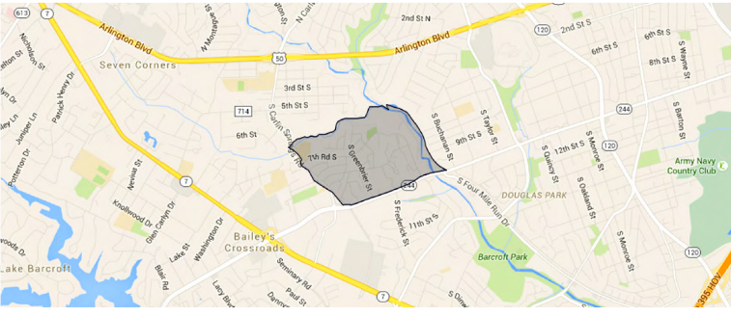
Census Tract 1022 in Columbia Heights, Arlington County

Slide 35
Columbia Heights
Ethnic composition
Socioeconomic status
67.5% Hispanic
Spanish spoken in 51.1% of households
South American (20.3%) or Sub-Saharan African (9.8%) ancestry
13.5% of residents speak African languages
Poverty rate = 23.9%
Median household income = $49,743
42.5% of children and teens live in poverty
Only 65.8% of adults have graduated from high school
Single-parent households = 23.8%
13.2% of homes are vacant

Slide 36
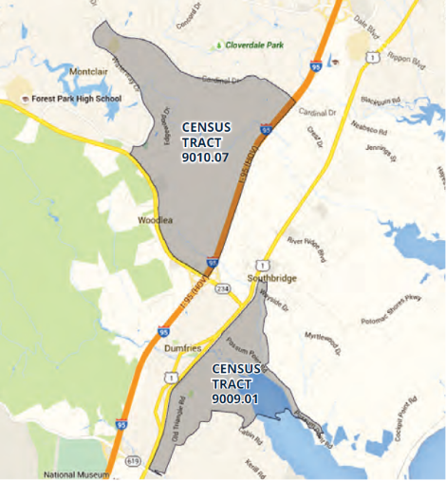
Dumfries vs. Montclair, Prince William County
Life expectancy
84 years
77 years

Slide 37
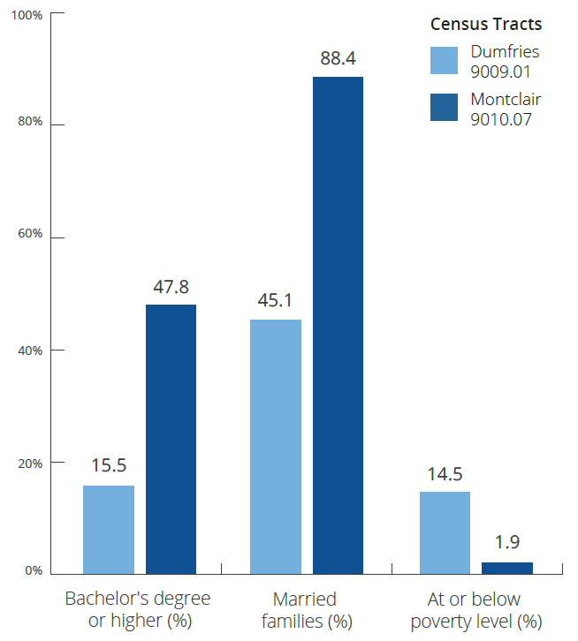
Dumfries vs. Montclair, Prince William County

Slide 38
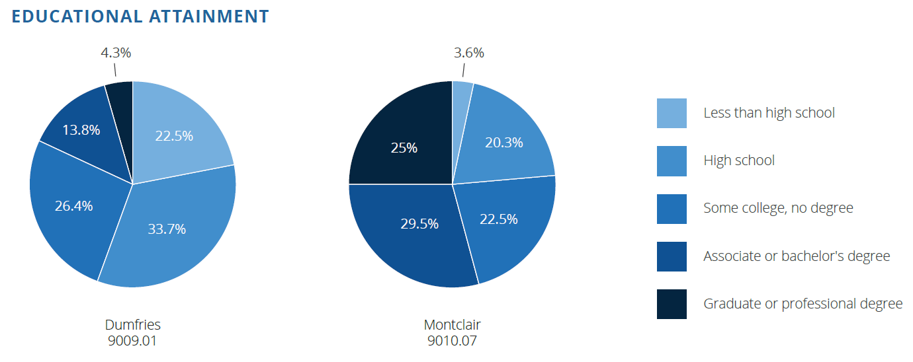
Dumfries vs. Montclair, Prince William County

Slide 39
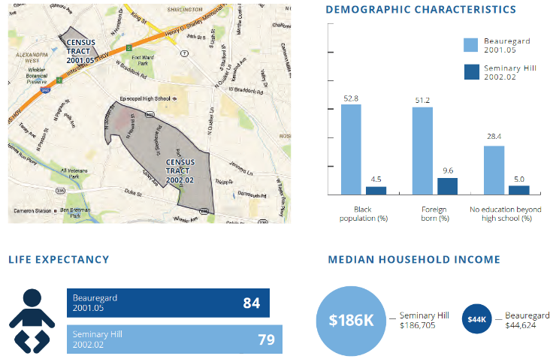
Seminary Hill vs. Beauregard, Alexandria

Slide 40
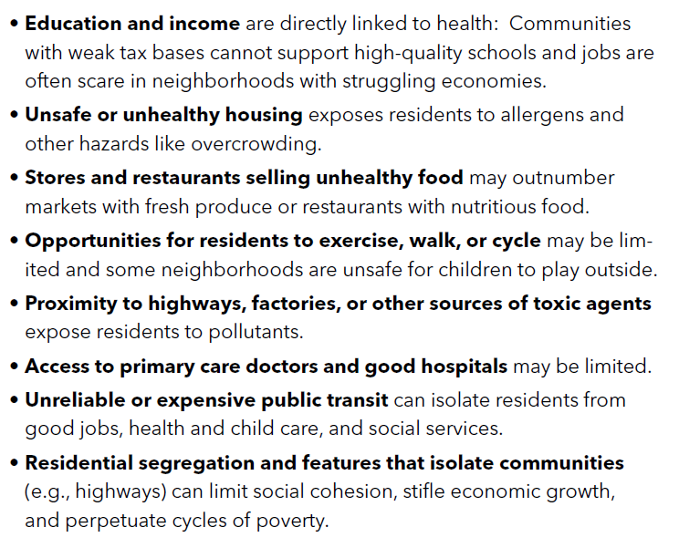
Why the Differences?

Slide 41
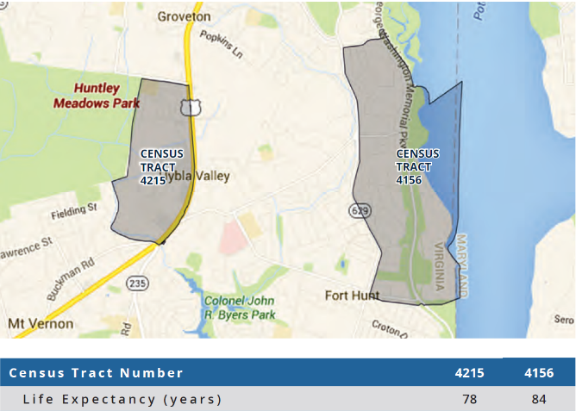
Hybla Valley vs Fort Hunt, Fairfax County

Slide 42
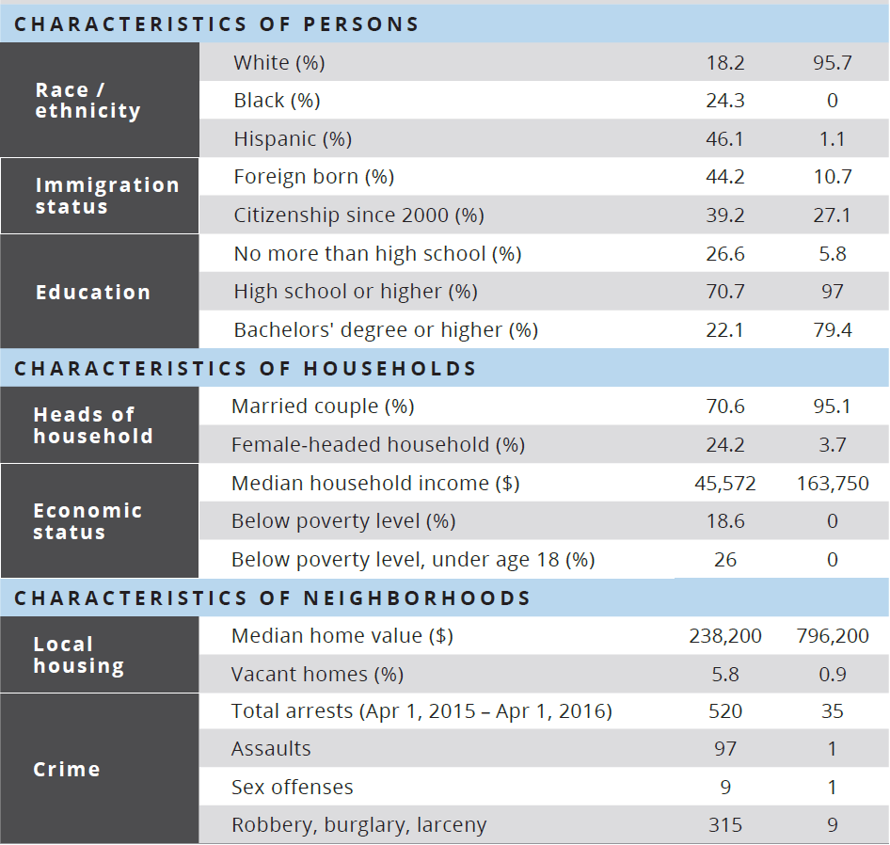

Slide 43
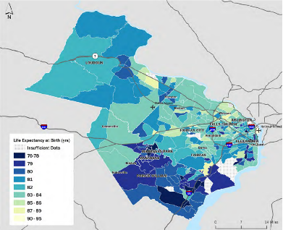
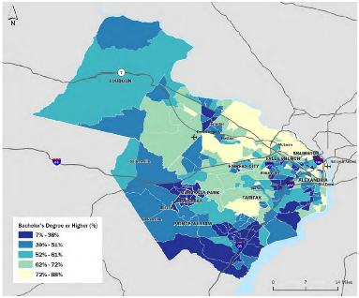
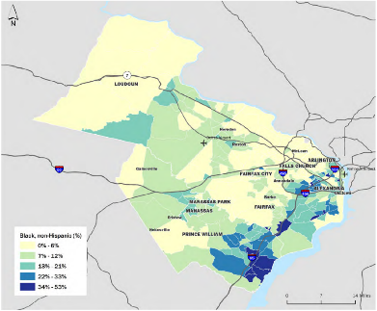
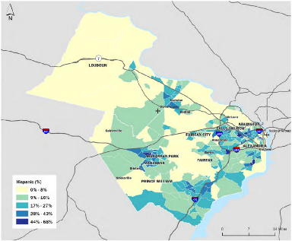

Slide 44
Policy implications
Wellness initiatives
Economic and social wellbeing
Early childhood education
Educational outcomes in secondary school
Post-secondary education accessible and affordable across social classes
Employment and income support
Mental health services
Environmental policy
Transportation infrastructure
Affordable housing, land use
Land use policy
Resources for growing immigrant population.

Slide 45
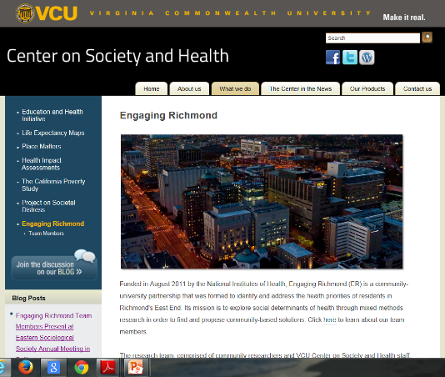
Contact Information
Steven H. Woolf, MD, MPH
Center on Society and Health
Department of Family Medicine and Population Health
Virginia Commonwealth University
(804) 628-2462
swoolf@vcu.edu
www.societyhealth.vcu.edu

Slide 46
Group Discussion
How could this data inform or advance your work?
Within your organization, who is the one person that needs to know about this the most?
What are you planning to do to address health across sectors?

