Slide 1



Impact of Childhood
Trauma on Health
Adverse Childhood Experiences and Resilience
Dr. Allison Sampson-Jackson, LCSW, LICSW, CSOTP
Integration Solutions, Inc.
804-432-0056
Notes:
Did you hear about the rose that grew from a crack in the concrete?
Proven nature's laws wrong it learned how to walk without having feet
Funny it seems but, by keepin its dreams
It, learned to breathe FRESH air
Long live the rose that grew from concrete
You see you wouldn't ask why the rose that grew from the concrete
Had damaged petals. On the contrary, we would all celebrate its
Tenacity. We would all love it's will to reach the sun
Well, we are the roses - this is the concrete - and these are
My damaged petals. Don't ask me why, ask me how!

Slide 2
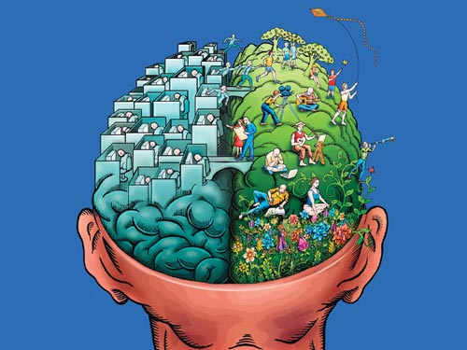
Impact to Right and Left Hemisphere Talk

Slide 3
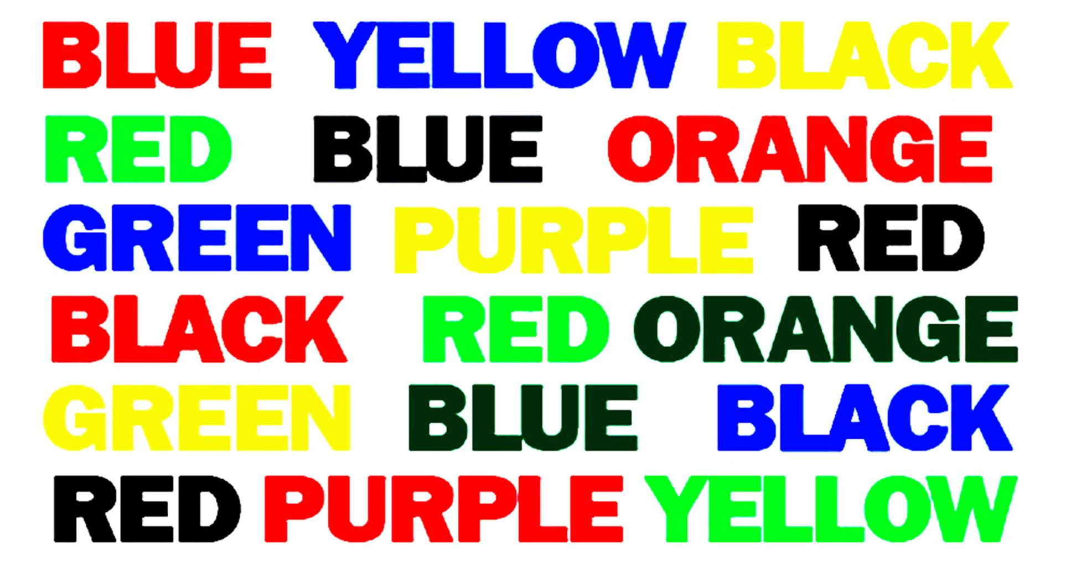
Left Right Brain Conflict

Slide 4

What is Trauma ?
Why Does it Matter?

Slide 5

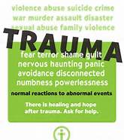
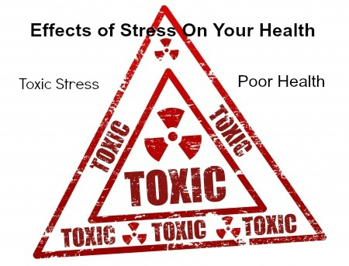

Slide 6
Defining Trauma
Individual trauma results from an event, series of events, or set of circumstances that is experienced by an individual as physically or emotionally harmful or life threatening and that has lasting adverse effects on the individual’s functioning and mental, physical, social, emotional, or spiritual well-being.
SAMHSA definition 2014
Notes:
In Fight Flight or Freeze …. Just talk about the brain.

Slide 7
Exposure to Violence in Childhood
46 million of 76 million children
are exposed to violence, crime and abuse each year
Finkelhor, D., et al. (2010). Trends in childhood violence and abuse exposure: evidence from 2 national surveys. Archives of Pediatric and Adolescent Medicine, 164(3), 238–242.

Slide 8








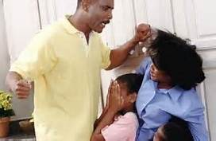

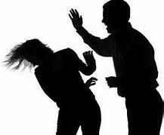
Notes:
ACE study started with CDC doing study on obesity, started to lose weight couldn’t keep it off, kept gaining it back- what they found was not what they expected, 10 factors that made it hard for them to keep a healthy weight- (refer to packet- ACE score, not going to ask anyone to share it, but look at it and keep it in your mind)
A whopping two thirds of the 17,000 people in the ACE Study had an ACE score of at least one – 87 percent of those had more than one. Eighteen states have done their own ACE surveys; their results are similar to the CDC’s ACE Study.
Remember this is a research tool or for your personal reflection now, not intended to be read to some one. Look at partnering with parents material.
Emotional abuse
Physically abuse
Sexual abuse
Not loved, not important
Poverty
Using drugs/substances
Separation/divorce
Mother- interpersonal violence
Substance abuse
Mentally health diagnosis
Prison
Score of 10, anyone ever worked in here with a kid who has an ACE score, adult who has an ACE score, 60-70% parents have ACE score and come back into system because they never got the treatment they needed as a child and are back as parents with their families now
Family that just keeps cycling, chances are there's an ACE score, genetically pass it on down to your DNA
General population- middle to upper class, access to health care, majority population- 2 out of 3 (224 million people) had at least 1 on ACE score, Dr. Harris (everyone had ADHD, looked at ACE study) we all need to know how to work with trauma, put trauma behavior specialists, did ACE read on every parent and child for well check (underreported) over 70% at least had 1 by age 7, not age 18
If you have 6 or above, 1500% more likely to use IV drugs, die 20 years younger than the average person, that’s how much it affects your health

Slide 9
Adverse Childhood Experiences –
A Primer Video
Emotional abuse
Physically abuse
Sexual abuse
Not loved, not important
Poverty
Using drugs/substances
Separation/divorce
Mother- interpersonal violence
Substance abuse
Mentally health diagnosis
Prison
*Remember this is a research tool or for your personal reflection now, not intended to be read to someone and used independently as a screen

Slide 10
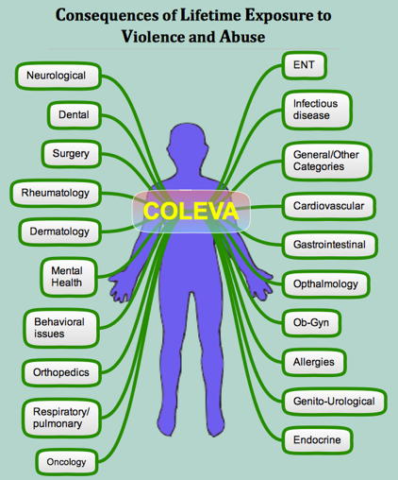
Alcoholism and alcohol abuse
Chronic obstructive pulmonary disease
(COPD)
Depression
Fetal death
Health-related quality of life
Illicit drug use
Ischemic heart disease (IHD)
Liver disease
Risk for intimate partner violence
Multiple sexual partners
Sexually transmitted diseases (STDs)
Smoking
Suicide attempts
Unintended pregnancies
Early initiation of smoking
Early initiation of sexual activity
Adolescent pregnancy

Slide 11
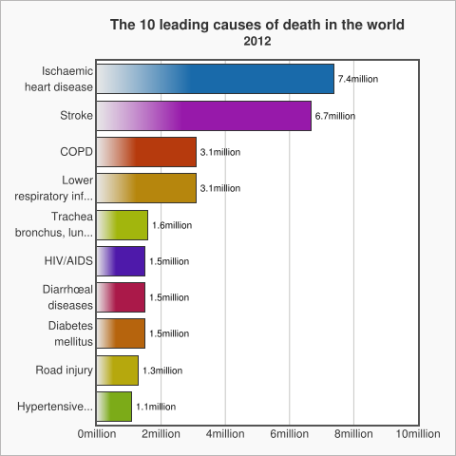
ACEs and Leading Causes of Death
Linked to 7 out of the 10
http://www.who.int/mediacentre/factsheets/fs310/en/
Notes:
ACEs contributes to 7 out of 10 of the leading causes of death

Slide 12



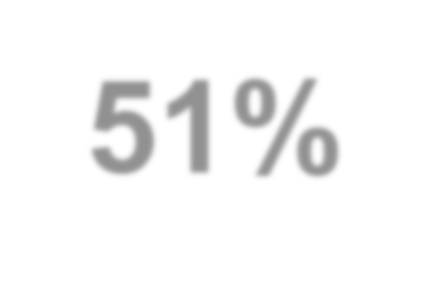








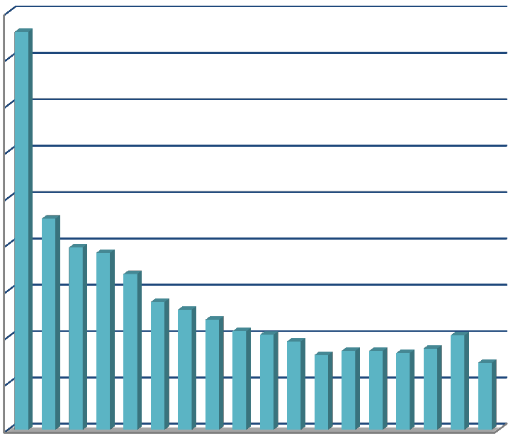
First 1000 Days is most vulnerable time for
child maltreatment:
51% abused
are ages 0-5
18.0%
16.0%
14.0%
12.0%
10.0%
8.0%
6.0%
4.0%
2.0%
0.0%
0 1 2 3 4 5 6 7 8 9 10 11 12 13 14 15 16 17
% of Children Removed
Children’s Bureau of the U.S. Department of Health and Human Services. (2014)
Age at Removal
7

Slide 13

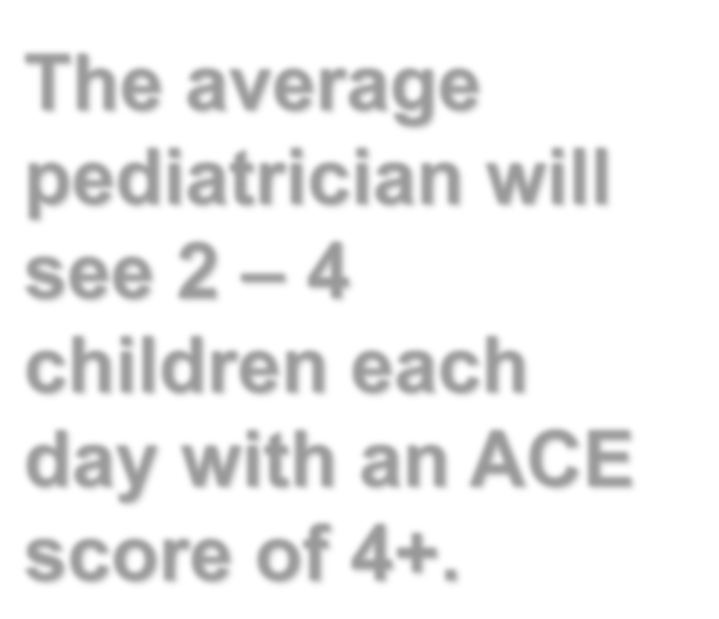

























The average pediatrician will see 2 – 4 children each day with an ACE score of 4+.
American Academy of Pediatrics (2015)
13

Slide 14
Shift from an ACE Score of 0 to 4
Population Health
242% more likely to smoke
222% more likely to become obese
357% more likely to experience depression
443% more likely to use illicit drugs
1133% more likely to use injected drugs
298% more likely to contract an STD
1525% more likely to attempt suicide
555% more likely to develop alcoholism

Slide 15
Trajectories of Risk Groups
Parents’
Childhood
High ACEs
Low ACEs
Their Children’s Contexts
High AAEs
Low AAEs
Consistently Low
Lessening
Increasing
Sustained High
Notes:
Sample sizes for each trajectory group are: 1) N=2,138 (60.2%), 2) N=805 (22.7%), 3) N=220 (6.2%), and 4) N=389 (10.9%)

Slide 16
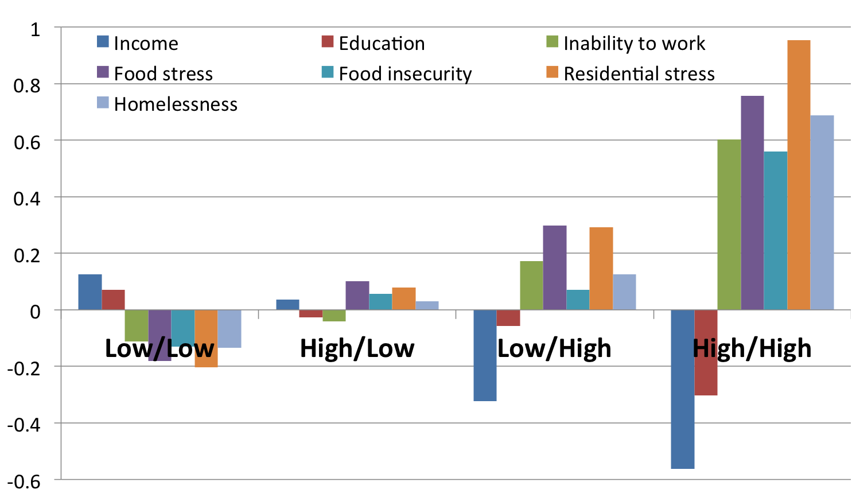
Figure 1. SES and Food/Housing Insecurity by Four Trajectories of Risk Groups
  Note: All the indicators are standardized.

Slide 17
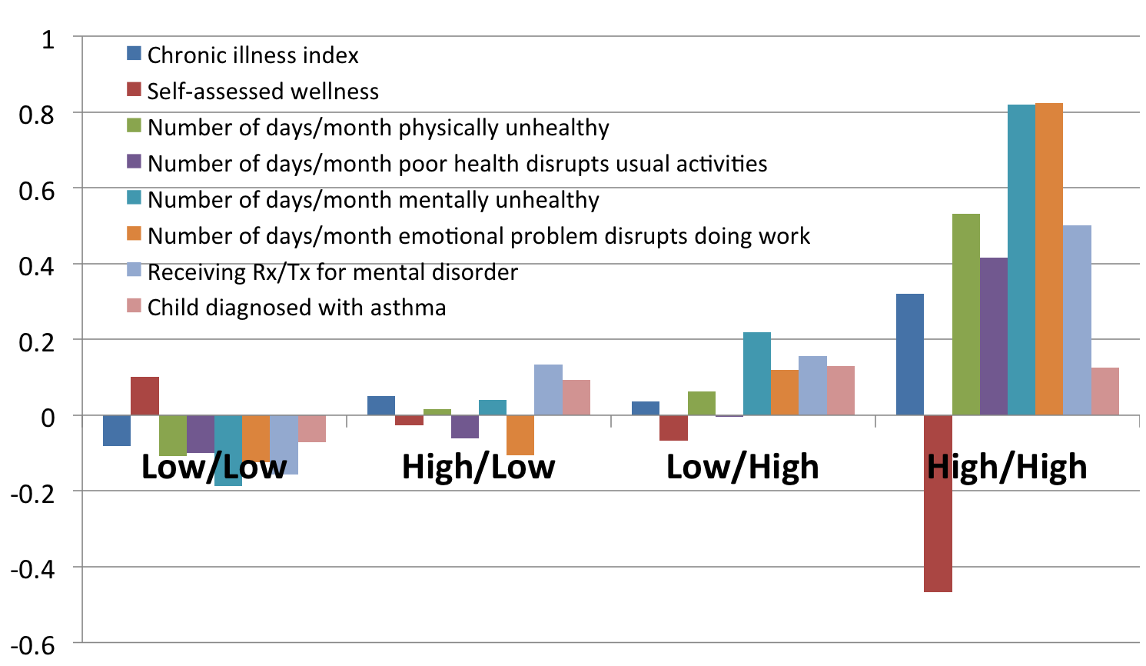
Figure 4. Physical Health, Mental Health, and Child Risk by Four Risk Transmission Groups

Slide 18
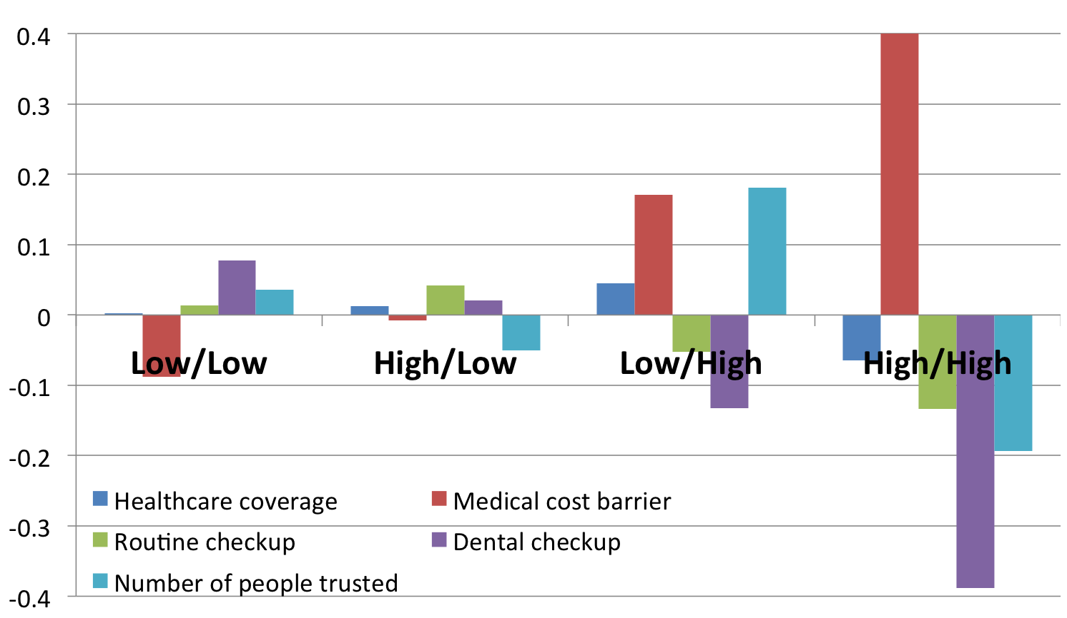
Figure 2. Health Care Access and Social Support by Four Trajectories of Risk Groups

Slide 19

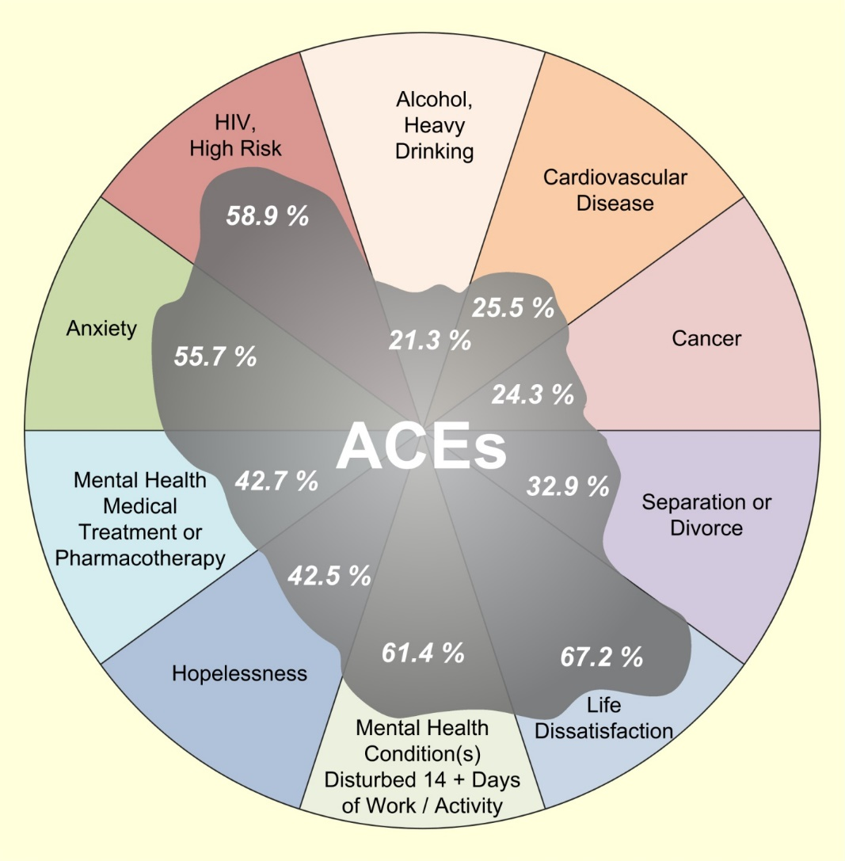
Population attributable risk
A large portion of many health, safety and prosperity conditions is attributable to Adverse Childhood Experience.
ACE reduction reliably predicts a decrease in all of these conditions simultaneously.
Notes:
Oil Spill and tell the story of the well and the diarrhea
19

Slide 20
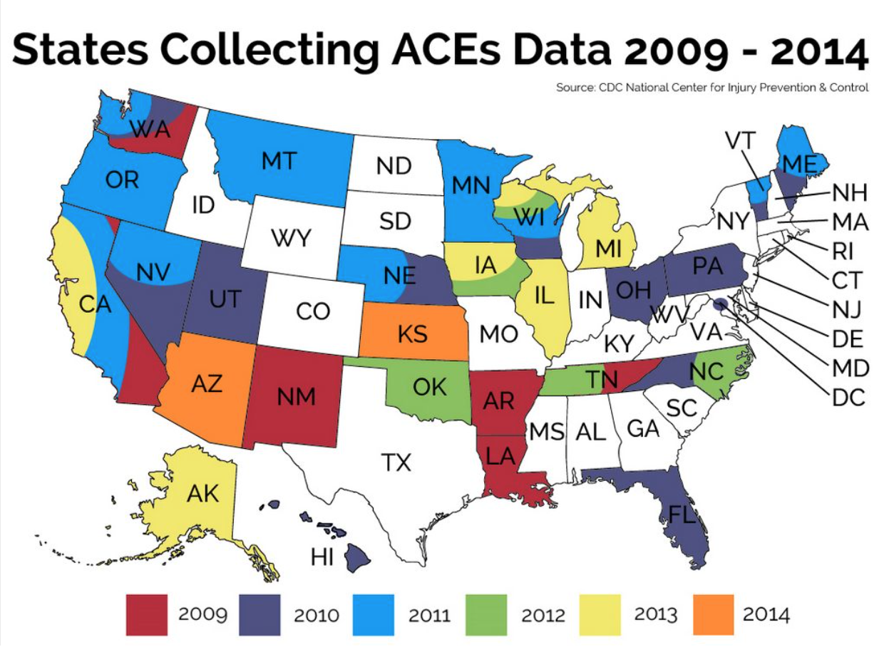
ACEs Data
2015
ACE Interface
Master Trainers
Active in 2016
Minnesota
Wisconsin
Alaska
South Carolina
Louisiana
Washington
East Iowa
Colorado
Oregon
Indiana
Sonoma County, CA
CO
SC
2015

Slide 21
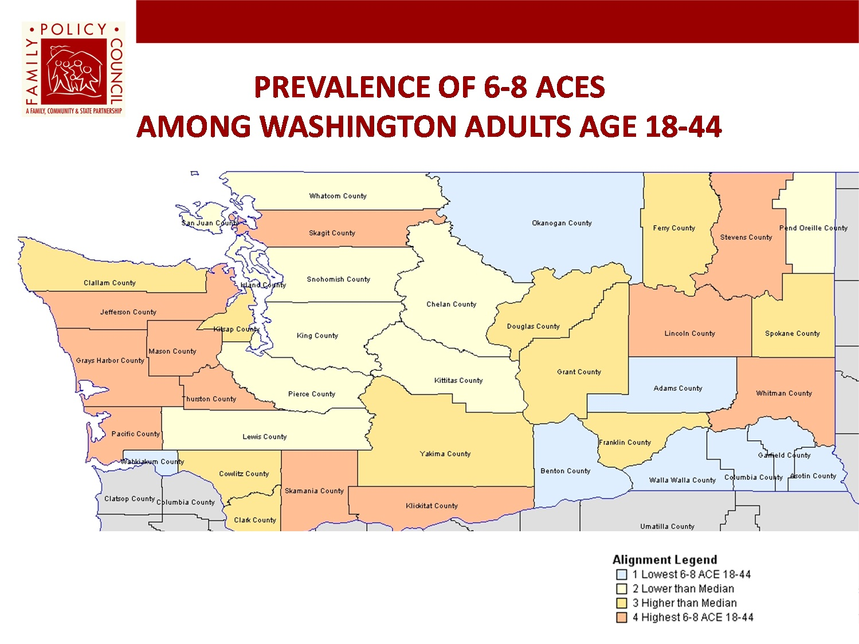
BRFSS Data in Washington Example
http://www.tulalipnews.com/wp/2014/09/03/adverse-childhood-experiences-aces-chronic-health-and-addiction-in-indian-country/
Notes:
Red – 12-22 percent with ACEs between 6-8
Yellow – 10-11 percent with ACEs between 6-8
Dark Blue - 8-9 percent ACEs between 6-8
Aqua – 6-7 percent ACEs between 6-8
Dark Green – 4-5 percent ACEs between 6-8
Light Green – 0-3 percent ACEs between 6-8

Slide 22
WHO – ACES IQ
Additional Categories
Questions cover family dysfunction; physical, sexual and emotional abuse and neglect by parents or caregivers; peer violence; witnessing community violence, and exposure to collective violence.
The current stage in the development of the ACE-IQ instrument, following international field-testing (2009-2011), is to test the reliability and validity of ACE-IQ by implementing it as part of broader health surveys in 6-8 countries. These surveys should aim to produce data that can be used to test the psychometric properties of the tool, compare findings across sites and with other studies, and check internal consistencies.

Slide 23

Theory of Change
https://www.youtube.com/watch?v=urU-a_FsS5Y

Slide 24
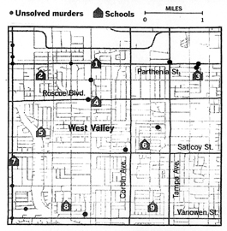

Slide 25
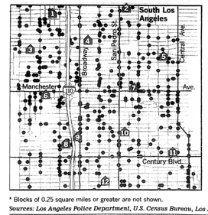

Slide 26
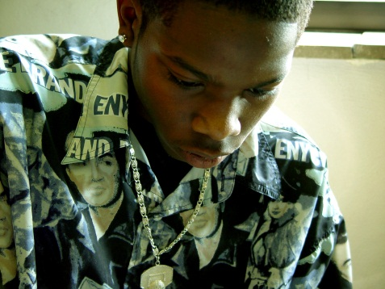

More suspensions and expulsions
(LAUSD survey, 2006)
Decreased IQ and reading ability
(Delaney-Black et al., 2003)
Lower grade point averalge
(Hurt et a., 2001)
Decreased rates of high school graduation
(Grogger, 1997)
More days absent from school
(Hurt et al., 2001)
Notes:
What is the result? Bottom line, children with trauma do worse in school. The impact of trauma on children in schools has been extensively documented with many studies: Children with traumatic histories are more likely to be referred for special education, have higher rates of school discipline referral and suspensions, lower test scores and grades and are less likely to graduate.

Slide 27

1 year of violence=
124 billion dollars in recovery costs
The breakdown per child is: $210,012
$32,648 in childhood health care costs
$10,530 in adult medical costs
$144,360 in productivity losses
$7,728 in child welfare costs
$6,747 in criminal justice costs
$7,999 in special education costs
Notes:
HighLight Youth Voice

Slide 28
Impact of being in Child Welfare System for Foster Care Children
25% will be incarcerated within first 2 years of aging out of the system
More than 20% will become homeless
Only 58% will have a High School Diploma
Less than 3% will have a college education by age of 25
Many will re-enter the system as parents
For children under age of 5, increase likelihood of developmental delays 13-62% compared to 4-10%
Conradi, L. (2012) Chadwick Trauma Informed System Project p. 54
Leslie et. al. (2005). Developmental and Behavioral Pediatrics 26(3), 177-185

Slide 29
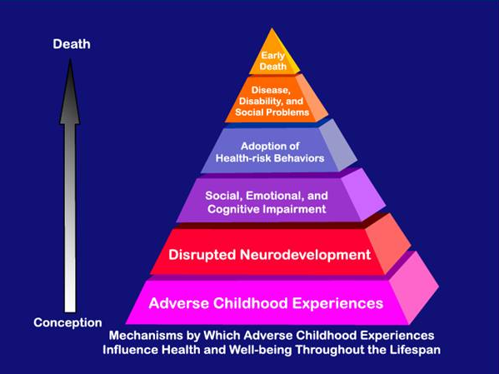
Notes:
HOWARD STORY

Slide 30
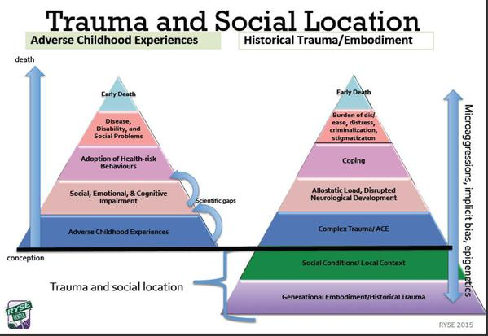

Slide 31
Respond to the need ….
Not react to the behavior

Slide 32

Resilience

Slide 33
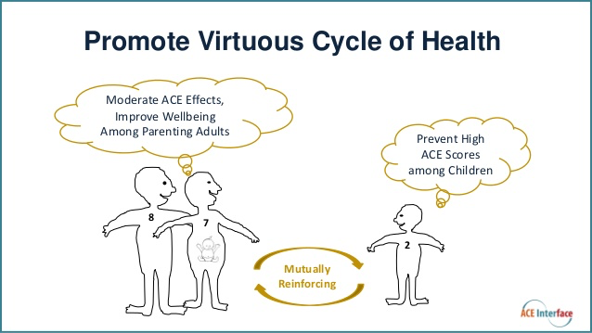
Creating the Virtuous Cycle

Slide 34

Resilience
Resilience has been shown to buffer the impact of suffering or stress. Resilience isn’t just a gift of nature or an exercise of will; resilience grows through positive experiences, supportive environments and the caring intervention of others.
http://communityresiliencecookbook.org/whats-cooking-here-and-why/

Slide 35
Building Coping Skills for
Persons with Complex Trauma

Slide 36
Core areas of focus in Complex Trauma
Courtois, C. & Ford, J. (2009), Introduction (p.2)
Self-Regulation
  Affect Regulation
  Disassociation (difficulty in being “present”)
  Somatic Dysregulation
Positive Self-Identity
  Impaired Self-Concept
  Impaired Self-Development
Co-regulation
  Secure working model of caring relationship
  Disorganized Attachment Patterns

Slide 37
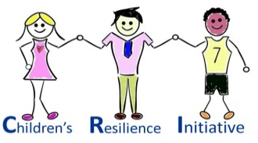

Children’s Resilience Initiative
Three basic building blocks to success:
Adapted from the research of Dr. Margaret Blaustein
Attachment - feeling connected, loved, valued, a part
of family, community, world
Regulation - learning about emotions and feelings and
how to express them in a healthy way
Competence - acting rather than reacting, accepting
oneself and making good choices
Notes:
The Boston Trauma Center, a leading organization in the field of trauma work, has developed a scheme made up of three building blocks – Attachment, Regulation and Competence.
37

Slide 38
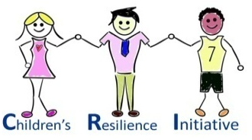
Children’s Resilience Initiative
SKILL BUILDING
Think: lack of skill not intentional
misbehavior
Think: building missing skills not shaming
for lack of skills
Think: nurture not criticize
Think: teach not blame
Think: discipline not punishment
Notes:
Reframe the misbehavior as possibly due to a lack of skills in areas such as impulse control, problem solving and empathy. Reframe as “skills deficit “ rather than purposeful behavior. This can lessen anger and punitive action (punishment) and instead invite interventions to develop and fortify the missing skills (Brooks 2012).
ANYONE (parent, teacher, staff administrators) must be involved in the process of nurturing a caring and respectful environment)- the MOST powerful new data indicates NURTURING is #1 in buffering ACE. Care and respect outweigh feelings of anger, blame and alienation
A main goal of discipline is to promote self-discipline. Ask child (student) to help create the rules and consequences, that empowers the child and provides a sense of ownership and personal control- major building blocks of resilience
38

Slide 39
Showing Resilient Cards

Slide 40
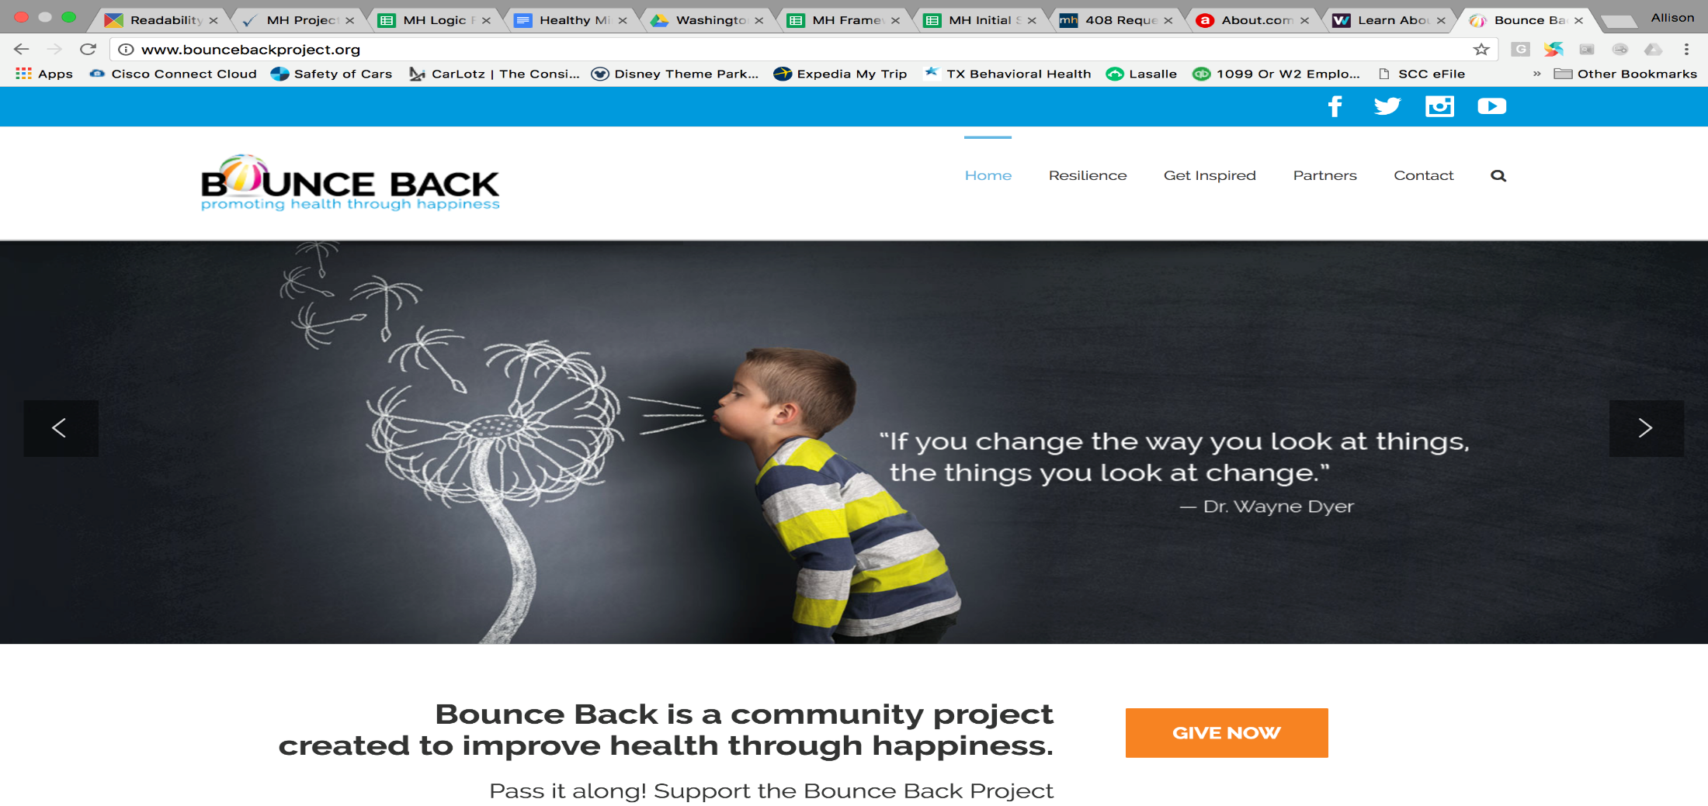
ACEs and Resilience
State-Wide Awareness Campaign
http://www.bouncebackproject.org/

Slide 41
Creating the Virtuous Cycle
Notes:
At individual level … we need to promote each adult/parent/child knowing this as the prime determinany of health (like texting while driving, like cigarette smoking)

Slide 42
NEAR SCIENCE
Neuroscience
Epigenetics
Adverse Childhood Experiences
Resilience
http://www.healthygen.org/resources/nearhome-toolkit
http://www.healthygen.org/resources/laura-porter-keynote-address-near-science-wa-state-resilience-findings

Slide 43
NEAR: What Help actually Helps ?
Support: Feeling socially and emotionally supported and hopeful
  Social Emotional Competence Building
  Hope and a Sense of Future
Help: Having two or more people who give concrete help when needed
  Concrete Supports (not Facebook Friends)
Community Reciprocity: Watching our for children, intervening when they are in trouble, and doing favors for one another
  Primary network of protection in your community
  People you see each day and see you
Social Bridging: Reaching Outside one’s immediate circle of friends to recruit help for someone inside that circle
  Asking for help
  Trusting Systems and People outside your circle to respond and be safe
http://www.healthygen.org/resources/laura-porter-keynote-address-near-science-wa-state-resilience-findings

Slide 44
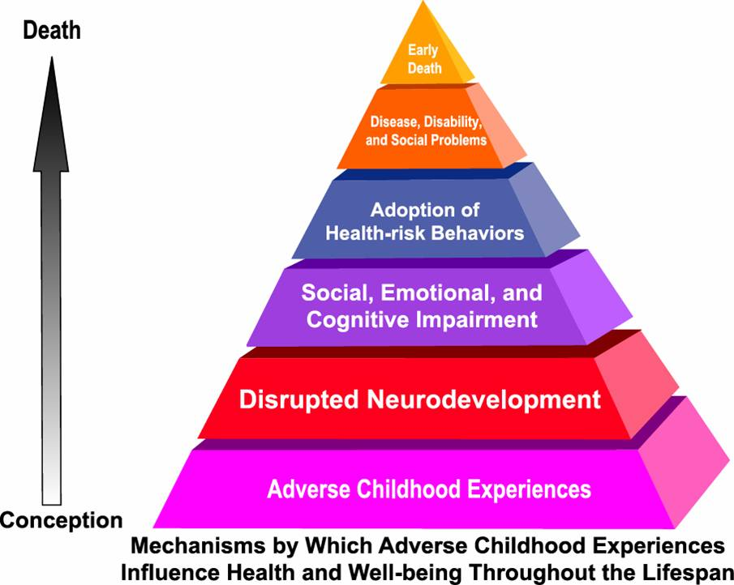

Adding Context, Stress Proliferation, & Moderators (+/-) to
ACE Influence on Lifespan Health and Functioning
Protective Resources
Adult Stressors
Educational & Work Achievement
Social Determinant Factors
Taken from: http://www.cdc.gov/ace/pyramid.htm
Notes:
This CDC model is a useful visual when thinking about how ACE exposure impacts health across the lifespan.
Early adversity predicts susceptibility to illness through processes that are complex, including inequalities in healthy living conditions, increased risk of social difficulties, and physiological dysregulation and damage. ACEs are theorized to be chronic and toxic stressors, indicating social conditions characterized by multiple forms of stress and risk that can negatively affect the developing brain and physiological systems.
Evidence is building that these stress-evoking conditions in the early years of life are part of the groundwork for decrements to later well-being, setting the stress response system on a “short fuse” that then serves as a pivotal mechanism through which later life challenges are experienced and adaptive responding undermined.
That is, stressors such as poverty and trauma place people on the “resource edge” in many domains, potentially reducing educational or employment achievement, constraining access to healthy social ties and lifestyles, limiting physical and leisure activities, and undermining successful experiences that fuel optimism. When high levels of life stress combine with relative depletion of resilience resources, a comparatively greater impact on health outcomes is likely.
By including issues such as historical trauma, environmental stressors, and education and work achievement, our aim is to build on the CDC health perspective to contextualize ACEs within a broader perspective of stressors.

Slide 45
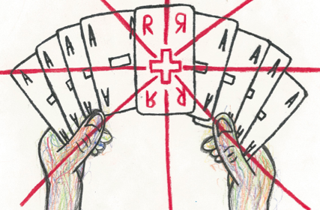
Be a F.O.R.S.E. in your community
Image by Lincoln High student Brendon Gilman
Focus
On
Resilience &
Social-Emotional

Slide 46
Resources
http://gucchdtacenter.georgetown.edu/TraumaInformedCare/index.html
https://www.youtube.com/watch?v=3axcjT_zo58
https://www.youtube.com/watch?v=-HG8H4n2j9I
https://www.ted.com/talks/nadine_burke_harris_how_childhood_trauma_affects_health_across_a_lifetime?language=en

Slide 47


Liked our Presentation?
Thank You
Dr. Allison Sampson-Jackson, LCSW, LICSW, CSOTP
Integration Solutions, Inc.
www.integrationsolutions.org
804-205-4461
Like our page Integration Solutions
integration_solutions

